Slide 1
Enterprise Education Series:
Low Earth Orbit (LEO)
Office of Enterprise Technology Solutions (ETS)
Information Technology Category (ITC)
Federal Acquisition Service (FAS)

Slide 2
Agenda
Types of Earth-Centered Orbit Satellites
LEO Satellite Overview
Capabilities
Use Cases
Guest Speaker
GSA Buyer’s Guide
Q&A

Slide 3
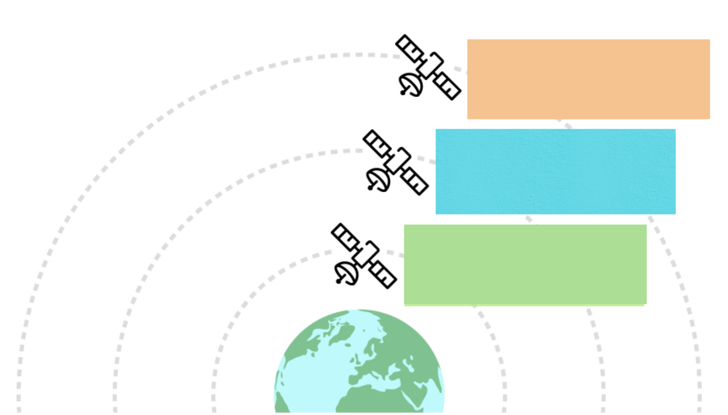
Types of Earth-Centered Orbit Satellites
Of the 9,800
active satellites,
LEO makes up
the largest
group.
Geostationary Orbit (GEO)
Altitude: 35,786 km
Latency: >500ms
Satellites in Orbit: 1,200
Achieving continuous
ZTA modernization
Medium-Earth Orbit (MEO)
Altitude: 2,000 - 35,000 km
Latency: <80ms
Satellites in Orbit: 300
Low-Earth Orbit (LEO)
Altitude: 160 - 2,000 km
Latency: <30ms
Satellites in Orbit: 8,300
Notes:
https://oceanweb.com/a-guide-geo-leo-and-meo-satellites/
https://geoxc-apps.bd.esri.com/space/satellite-explorer/
https://nanoavionics.com/blog/how-many-satellites-are-in-space/
9,800 active satellites GEO 12% MEO 3% LEO 84%

Slide 4
LEO vs. MEO vs. GEO
https://geoxc-apps.bd.esri.com/space/satellite-explorer/
Achieving continuous
ZTA modernization

Slide 5
Low Earth Orbit (LEO) Satellite Overview
Low-Earth Orbit satellites orbit the Earth at a low altitude, closer than other satellites.
Benefits to leveraging LEO satellites for your agency:
Global
coverage
Connectivity
in remote
areas
Achieving continuous
ZTA modernization
Lower cost & lower energy requirements
Fast Orbit (90-120 mins)
Low
Latency
Versatility
Notes:
LEO (Low-Earth Orbit) Satellites work in interconnected constellations, forming a network that provides global coverage. They are primarily uses to commercial internet services and imagery service.
Allows users to connect to their network in remote or low populated areas.
1,200 miles above earth
Low Latency
Global network
Fast Orbit circling the Earth multiple times a day

Slide 6
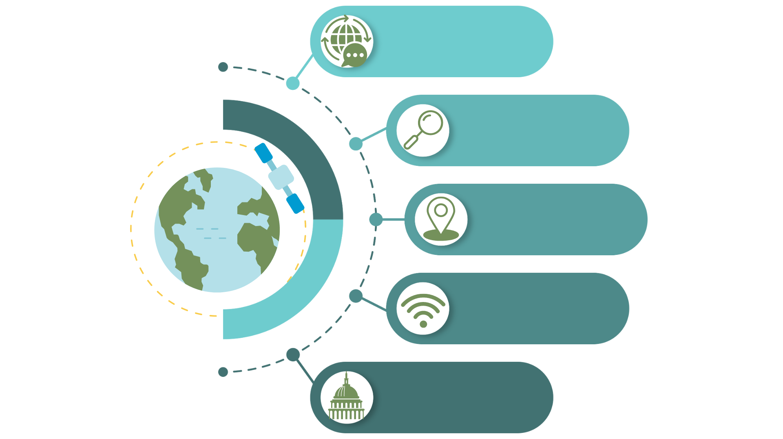
LEO Capabilities
Global
Communication
Close proximity
to Earth
makes LEO satellites ideal
for real-time applications.
Earth Observation
Achieving continuous
ZTA modernization
Navigation
Connectivity in Remote areas
Military & Civilian Operations
6

Slide 7
LEO Use Cases
Remote Areas
Military
Emergency Response
System Upgrade
& Backup

Slide 8
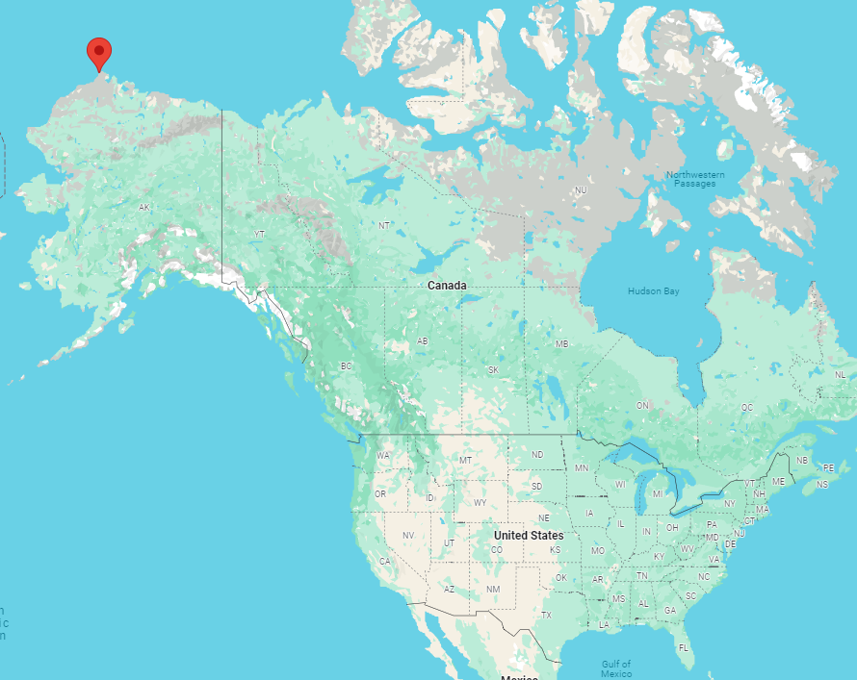
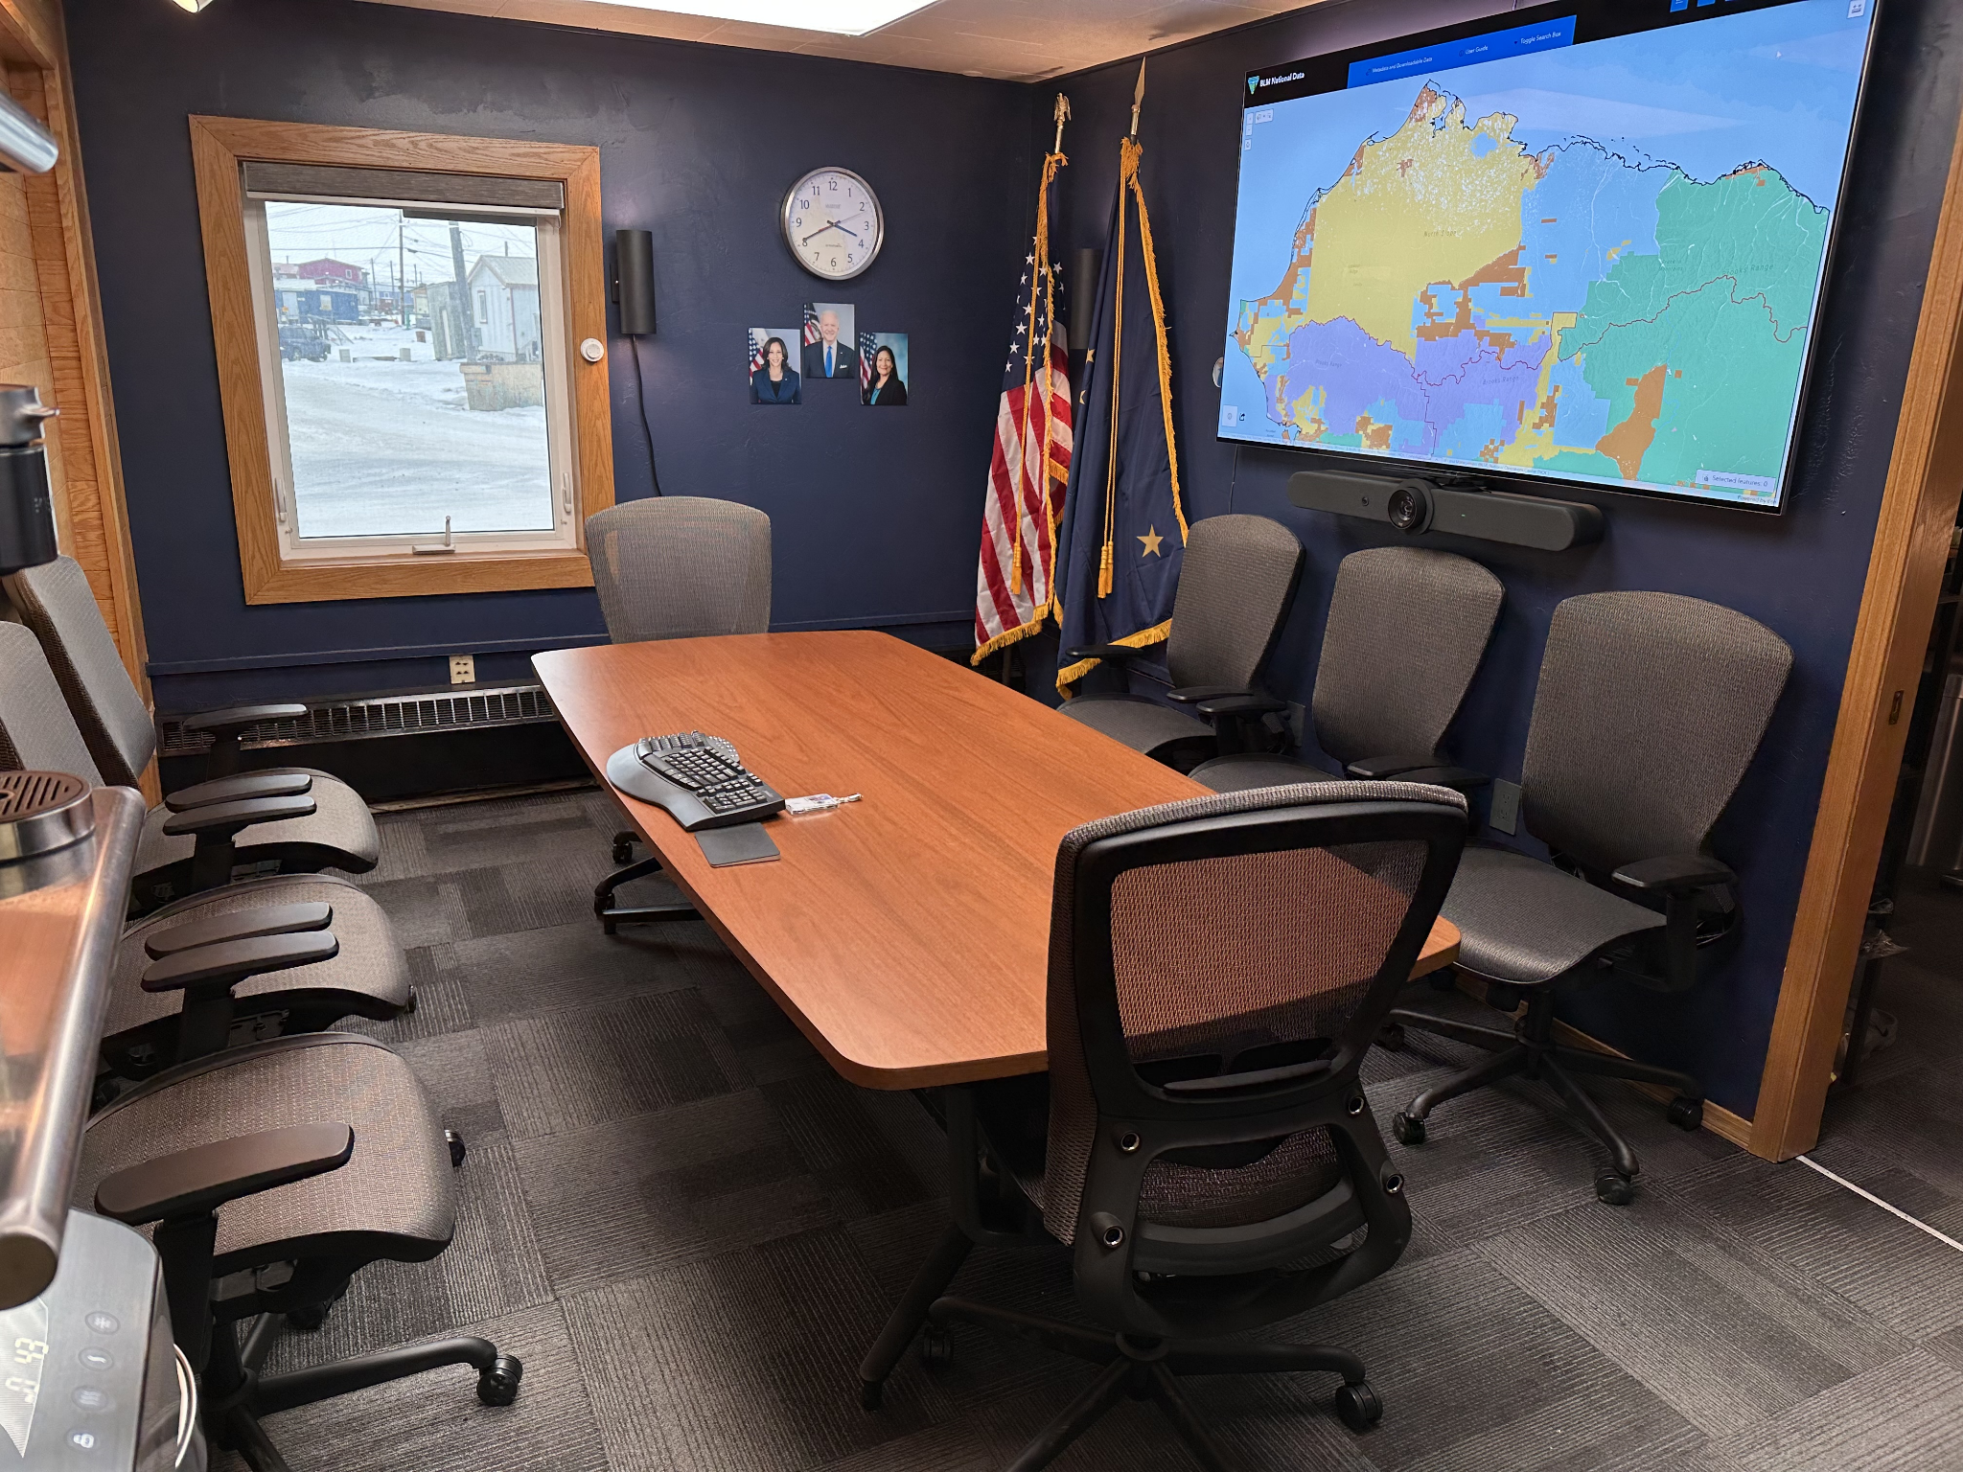
Special Guest: Frank Damiano
Utqiagvik, AK
Notes:
Bio: Frank currently works for the Bureau of Land Management (BLM) as a Community Outreach Specialist for the past 2 years. He is stationed in Utqiagvik, AK (which is the northernmost community in the United States). In between military service and joining the BLM Frank founded and operated a software engineering firm that specialized in turn-key technology solutions. Over the past year and and a half Frank has sourced, installed, and manages three commercial LEO systems for local Arctic clients.
Disclaimer:
After discussion with the Communications team, we are comfortable with you participating in this webinar, as long as you state at the beginning that:
You are speaking as someone who happens to work at the BLM in the Arctic and uses these types of services,
Your comments are your own and not those of the BLM, and
Your participation doesn’t signify the BLM’s endorsement of any particular technology.
Additionally,
Please limit yourself to speaking about your experience with the technology, and not the potential work that BLM could do with the technology.
Frank are you using LEO service for webinar?
Weather
Final thoughts

Slide 9
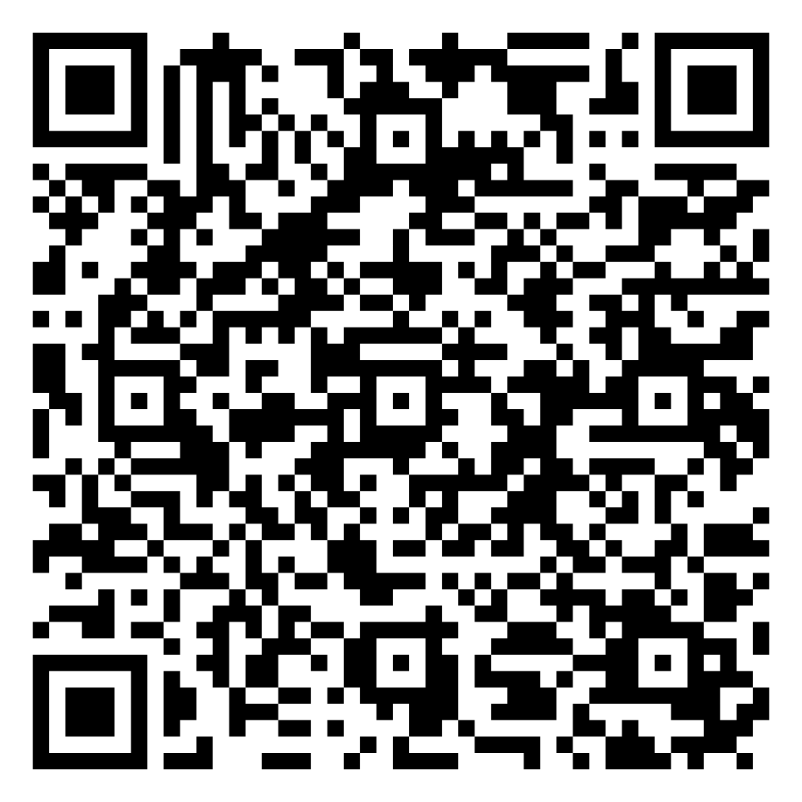
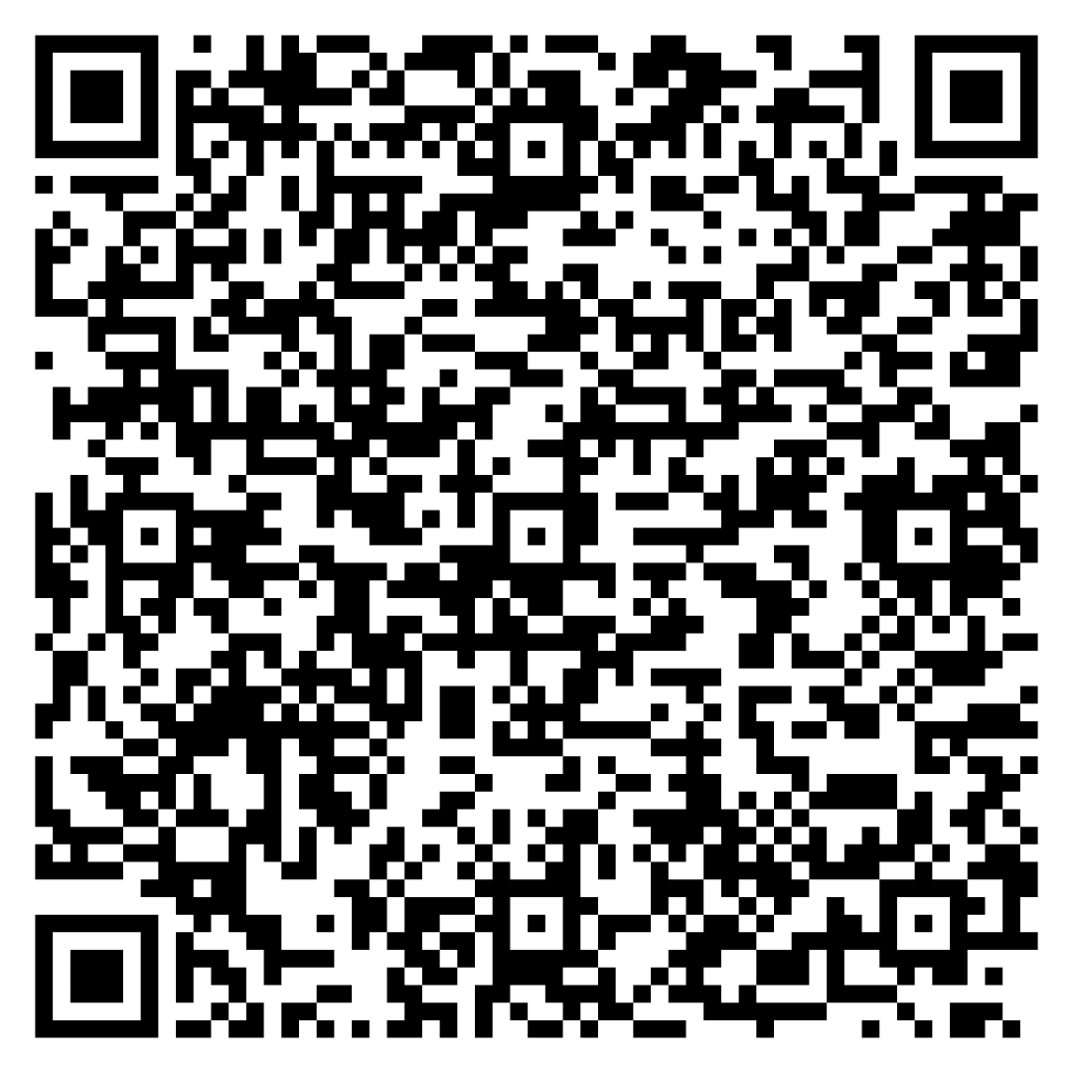
GSA Buyer’s Guide
COMSATCOM Webpage
CS3 Ordering Guide
How do I buy LEO services through GSA?

Slide 10
GSA Support
Contact the COMSATCOM
Intake Mailbox:
satcom@gsa.gov
Contact the Solutions Development
Intake Mailbox:
sdintake@gsa.gov
Notes:
Provide distinction between the two teams (SB/SD): SBs = agency level
SDs = technical team helping with requirements

Slide 11
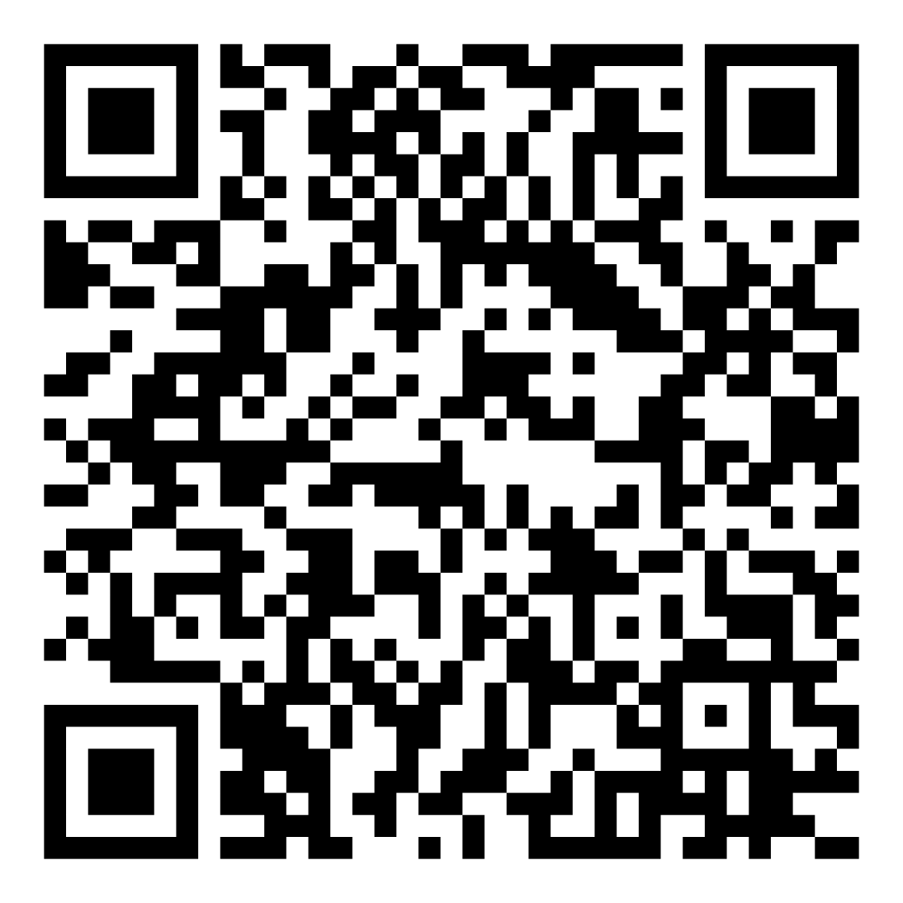
Save the Date for our next event!
Enterprise Education Series:
SD-WAN February 12, 2025 1pm Eastern
Registration is now open. Reserve your spot today.

Slide 12
Let’s Stay Connected
Follow us on our LinkedIn social community to stay informed!

Slide 13
Q&A

